Slide 1
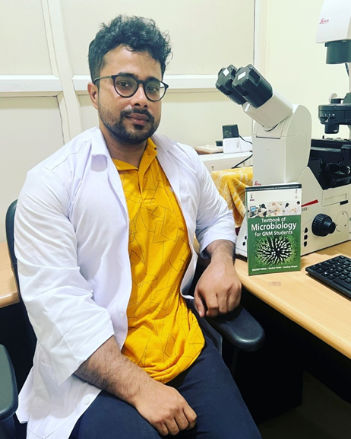
Day 3: Advanced CRISPR-Cas gene editing techniques, ethics and regulation
Dr. Darshan Panda
Researcher (ICAR-NRRI)
Cuttack-753006
Odisha , India
darshan.panda216@gmail.com

Slide 3
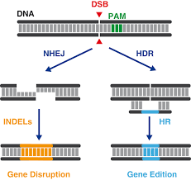
NHEJ (Non-homologous End Joining) and HDR (Homology-Directed Repair) are two distinct mechanisms by which cells repair DNA double-strand breaks (DSBs) induced by CRISPR-Cas9. The choice between these repair pathways significantly impacts the outcome of CRISPR-Cas9 editing.
Non-Homologous End Joining (NHEJ)
NHEJ is a rapid and error-prone repair pathway that directly ligates the broken DNA ends, often resulting in small insertions or deletions (indels) at the repair site. NHEJ is the predominant repair mechanism in mammalian cells and is typically favored in the absence of a homologous DNA template.
Homology-Directed Repair (HDR)
HDR is a more complex and precise repair pathway that utilizes a homologous DNA template to guide the repair process. HDR is less frequent than NHEJ but can be favored by providing a homologous DNA template, such as a donor plasmid or a sister chromatid. HDR can introduce precise edits, including insertions, deletions, and base substitutions, depending on the nature of the donor template.

Slide 4
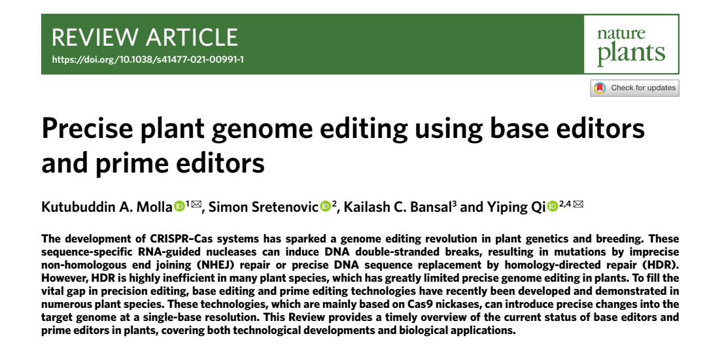

Slide 5
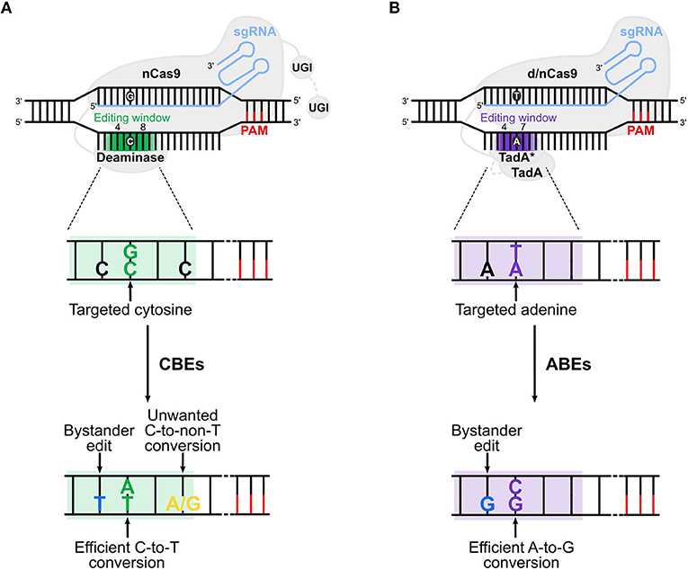
Base editing : This allows for direct conversion of one nucleotide base to another without introducing double-stranded breaks (DSBs) in the DNA. This is achieved using specialized Cas9 enzymes that are nickases, meaning they only cleave one strand of DNA. Base editors also contain deaminases or other enzymes that modify the base on the opposite strand, leading to the desired base change. Base editing is particularly useful for correcting single nucleotide variants (SNVs) associated with genetic diseases.
FIGURE 1 | Cytosine and adenine base editors. (A) Cytosine base editors (CBEs), composed of a nickase Cas9 (nCas9) fused to a deaminase and one (in BE3s) or two (in BE4s) UGI (uracil glycosylase inhibitor), convert C:G into T:A base pairs in the editing window (nucleotide 4 to 8 in the protospacer, in green). (B) Adenine base editors (ABEs) are composed of a dead (d) or nickase (n) Cas9 (d/nCas9) fused to two TadA, one evolved to edit adenine in DNA (TadA*) and one wild type (TadA). ABEs convert A:T into G:C base pairs in the editing window (nucleotide 4 to 7 in the protospacer, in purple). Cas9 is guided by the sgRNA to the protospacer [which is followed by the PAM (protospacer adjacent motif)], unwinds the DNA and the deaminase converts the target base. Undesired events (bystander edits, in blue, and unwanted base conversion, in yellow) of CBEs and ABEs are shown in (A,B), respectively. The addition of the second UGI in CBEs (in BE4) and the removal of TadA in ABEs (ABE8) are highlighted with a gray dotted line. The gradient color of the editing window in the upper panels of (A,B) represents the enlarged editing window observed with novel BEs.

Slide 6
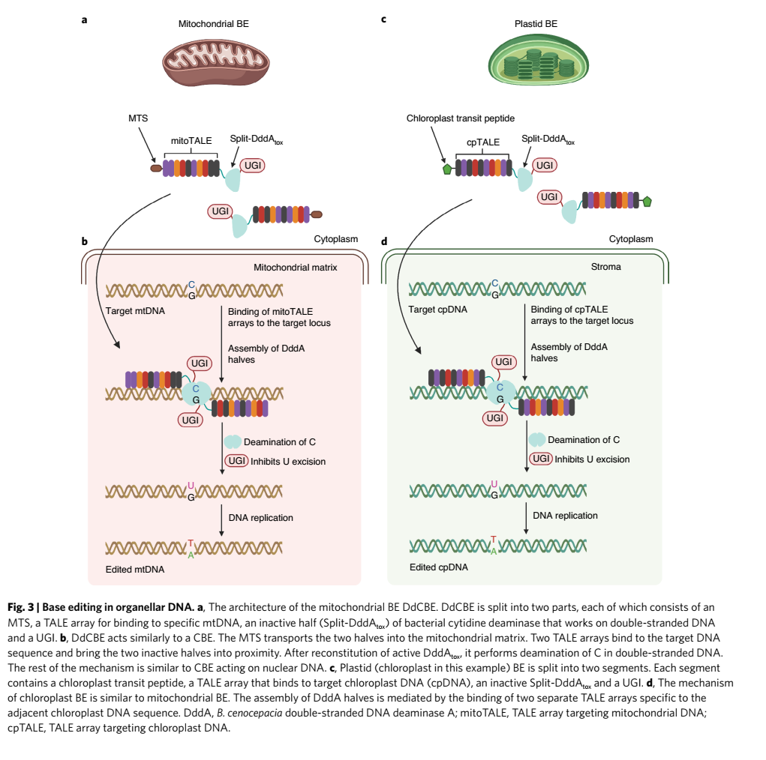

Slide 7
Base editing in CRISPR/Cas9 involves a series of steps to precisely modify single nucleotides within the DNA sequence without introducing double-stranded breaks (DSBs). Here's a detailed breakdown of the process:
Step 1: Design and Synthesis of sgRNA
Identify the target DNA sequence where you want to introduce the base change.
Design an sgRNA (single-guide RNA) that specifically targets the desired location within the target DNA sequence.
Synthesize the sgRNA using in vitro transcription or other suitable methods.
Step 2: Preparation of Base Editor Complex
Prepare the base editor complex, which consists of:
a. Catalytically inactive Cas9 (dCas9) protein: This protein is engineered to lack nuclease activity, preventing it from cleaving the DNA.
b. Base-converting enzyme: This enzyme catalyzes the conversion of one nucleotide base to another at the specified target site.
c. DNA glycosylase inhibitor: This protein prevents the removal of the modified base by DNA glycosylases, ensuring the stability of the base change.
Step 3: Delivery of Base Editor Complex and sgRNA
Choose an appropriate delivery method to introduce the base editor complex and sgRNA into the target cells. Common methods include:
a. Lipofection: Using liposomes to encapsulate and deliver the base editor complex and sgRNA.
b. Electroporation: Applying electrical pulses to create temporary pores in the cell membrane, allowing the base editor complex and sgRNA to enter the cells.
c. Viral transduction: Utilizing viruses to transport the base editor complex and sgRNA into the cells.
Step 4: Base Editing and DNA Repair
Once inside the cells, the base editor complex binds to the target DNA sequence guided by the sgRNA.
The base-converting enzyme modifies the specific nucleotide base at the target site, introducing the desired base change.
Cellular DNA repair mechanisms, such as base excision repair (BER), recognize the modified base and remove it.
The DNA polymerase incorporates the complementary base, resulting in the desired base conversion.
Step 5: Screening and Validation
Screen the edited cells to identify those with the desired base change. This can be done using various methods, such as Sanger sequencing or PCR-based assays.
Validate the base edit by sequencing the target DNA region in multiple clones to confirm the presence and accuracy of the base change.
Step 6: Functional Analysis
Assess the functional consequences of the base edit. This may involve analyzing changes in gene expression, protein activity, or cellular phenotypes.
Interpret the results to understand the role of the modified base in the biological process under study.

Slide 8
Base editing in CRISPR/Cas9 has emerged as a valuable tool for precise genome engineering, offering several advantages over traditional CRISPR/Cas9-mediated gene editing techniques. Here are some of the most important aspects of base editing in CRISPR/Cas9:
1. Precision and Specificity:
Base editing enables precise modification of single nucleotides within the DNA sequence without introducing double-stranded breaks (DSBs), unlike traditional CRISPR/Cas9 editing that relies on DSB repair mechanisms. This precision reduces the risk of off-target effects and unintended mutations, making base editing a safer and more specific tool for genome engineering.
2. Versatility and Efficiency:
Base editing can efficiently convert one nucleotide base to another, including transitions (C to T or G to A) and transversions (C to A or G to T). This versatility allows for a wide range of genetic modifications, such as correcting disease-causing mutations, introducing beneficial mutations, or optimizing genetic sequences for specific applications.
3. Reduced Off-Target Effects:
Due to the absence of DSBs, base editing typically exhibits lower off-target effects compared to traditional CRISPR/Cas9 editing. This reduced off-target activity makes base editing a more reliable and predictable tool for gene editing, especially in sensitive applications like therapeutic genome engineering.
4. Suitability for Non-Dividing Cells:
Base editing can be applied to both dividing and non-dividing cells, expanding its applicability to a wider range of cell types and organisms. This versatility makes base editing suitable for therapeutic applications targeting non-dividing cell types, such as neurons or mature blood cells.
5. Expanding CRISPR/Cas9 Capabilities:
Base editing complements traditional CRISPR/Cas9 editing by providing a precise and efficient method for single-nucleotide modifications, broadening the capabilities of CRISPR/Cas9 technology. This expansion enables researchers to address a wider range of genetic and therapeutic challenges.

Slide 9
Prime Editing: Prime editing combines the precision of base editing with the versatility of CRISPR/Cas9-mediated DSB repair. It utilizes a Cas9 nickase and a reverse transcriptase (RT) to introduce specific base changes or small insertions/deletions (indels) into the target DNA. Prime editing provides a versatile tool for correcting mutations, introducing new sequences, or modifying regulatory elements.

Slide 10
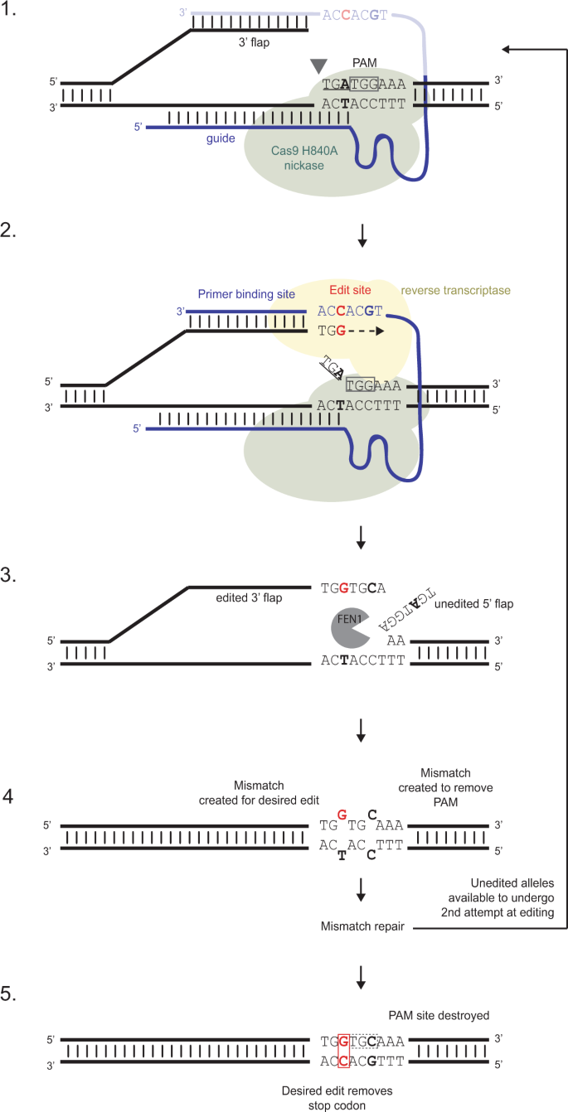
Prime editing in five steps. Prime editing has just two components, a Cas9 nickase fused to a modified reverse-transcriptase (referred to as PE2) and a multifunctional prime editing guide RNA (pegRNA). 1 The Cas9-H840A/pegRNA complex binds to the desired target region and creates a nick 3 bp upstream of the PAM site. The nick must be upsteam of the first variant site (in this case a TGA stop codon) and occurs on the same strand as the PAM liberating a 3’ flap. 2 This 3’ flap forms a sequence-specific interaction with the 14-16 nt “primer binding site” located at the 3’ end of the pegRNA. This RNA/ DNA hybrid serves as the PRIMEr site for new DNA synthesis using the RNA “edit site” as a template; the modified RT polymerase copies the template thereby extending the 3’ flap. 3 The edited 3’ flap displaces the variant unedited 5’ flap, which is removed by a cellular nuclease FEN1. 4 In this example, this leaves two MisMatches to be resolved, one in the edited codon (G ≠ T), and one in the modified PAM (C ≠ C) which can be introduced as an option to prevent further editing to the corrected sequence. 5 MisMatch Repair resolves the DNA resulting in either precisely edited DNA (with no indels), or the original variant sequence. In the latter case where the PAM sequence has not been modified, the Cas9-H840A/pegRNA complex can bind to the variant sequence again and have another attempt at PRIME editing. Key: Cas9-H40A nickase shown in Green, Reverse Transcriptase in yellow. The PAM site is highlighted in a grey box; the pegRNA in blue; the 3’ edit site in red; the edited PAM site in bold; FEN1 in grey. For clarity, only part of the pegRNA is shown in step 1.

Slide 11
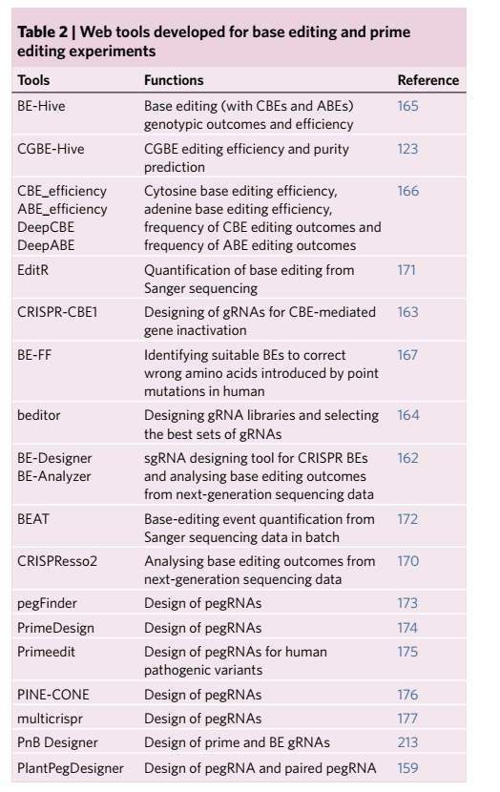

Slide 12
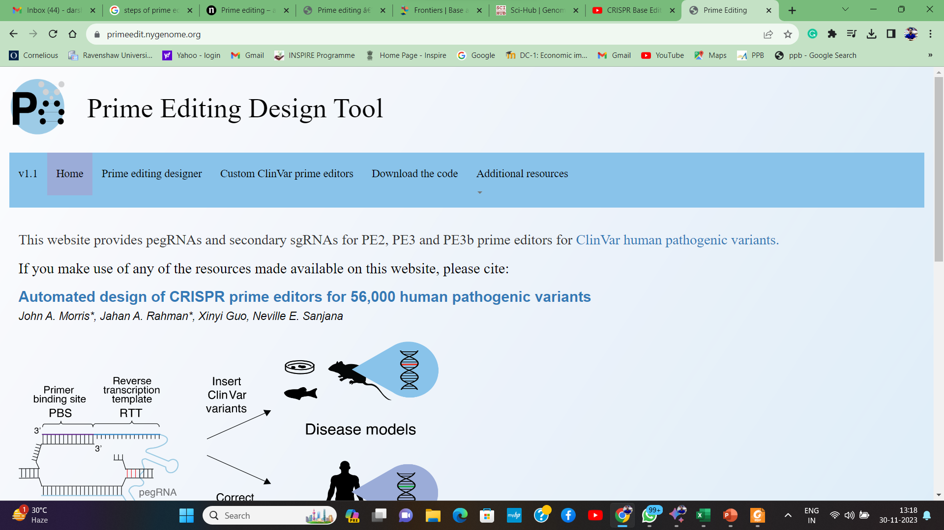

Slide 13
Base Editing Applications:
Correcting Disease-Causing Mutations: Base editing can precisely correct single-nucleotide variants (SNVs) associated with various genetic disorders, potentially offering therapeutic solutions for diseases like cystic fibrosis, sickle cell anemia, and Huntington's disease.
Introducing Beneficial Mutations: Base editing can introduce beneficial mutations into genes to enhance desired traits, such as improving crop yields, increasing resistance to diseases, or modifying metabolic pathways.
Optimizing Genetic Sequences: Base editing can optimize genetic sequences for specific applications, such as engineering enzymes with enhanced properties or modifying regulatory elements for better gene expression control.
Prime Editing Applications:
Expanding the Scope of Gene Editing: Prime editing can perform a broader range of edits than base editing, including insertions, deletions, and combinations of these, significantly expanding the scope of gene editing applications.
Correcting Complex Mutations: Prime editing can correct complex mutations, such as frameshift mutations and large deletions, which are difficult to address with traditional CRISPR-Cas9 editing or base editing.
Introducing Conditional Genetic Changes: Prime editing can introduce conditional genetic changes that only occur under specific conditions, such as the presence of a specific molecule or environmental cue, enabling precise control over gene expression.

Slide 14
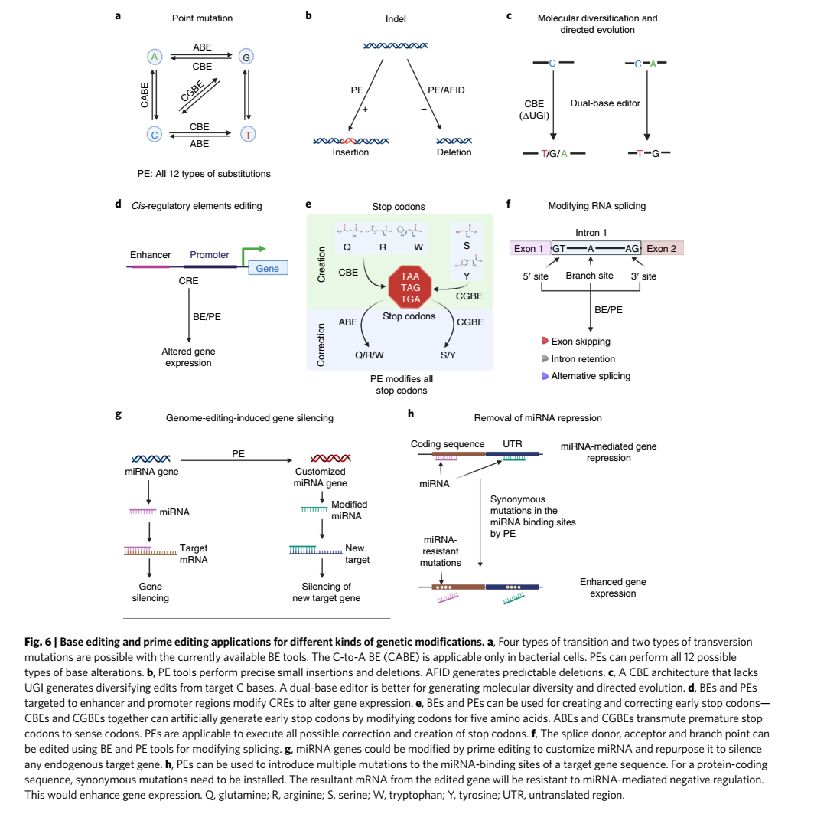

Slide 15
A knock-in gene using CRISPR-Cas9 is a technique that allows scientists to introduce a specific gene or DNA sequence into a particular location in the genome of an organism. This technique is based on the CRISPR-Cas9 system, which is a naturally occurring bacterial defense mechanism that has been adapted for use in gene editing.

Slide 17
CRISPR-Cas9-mediated methylation editing, also known as epigenetic editing, is a powerful technique that allows for precise and efficient modification of DNA methylation patterns. This technique utilizes the CRISPR-Cas9 system to target specific DNA sequences and introduce or remove DNA methylation marks, such as 5-methylcytosine (5mC), influencing gene expression without altering the DNA sequence. There are two main strategies for CRISPR-Cas9-mediated methylation editing:
CRISPR Activation (CRISPRa): This strategy employs dCas9 (catalytically inactive Cas9) fused to a transcriptional activator domain to recruit histone acetyltransferases (HATs) to target DNA sequences. HATs add acetyl groups to histone tails, promoting a more open chromatin conformation and enhancing gene expression.
CRISPR Interference (CRISPRi): This strategy utilizes dCas9 fused to a transcriptional repressor domain to recruit histone deacetylases (HDACs) to target DNA sequences. HDACs remove acetyl groups from histone tails, promoting a more condensed chromatin conformation and repressing gene expression.

Slide 19
Applications of CRISPR-Cas9 Epigenetic Editing
CRISPR-Cas9-mediated methylation editing has a wide range of potential applications, including:
Functional Genomics Studies: Studying the role of DNA methylation in gene expression and regulation.
Therapeutic Applications: Developing treatments for diseases associated with aberrant DNA methylation patterns, such as cancer and developmental disorders.
Biotechnology Applications: Engineering microorganisms with altered methylation patterns for improved industrial applications.
Advantages of CRISPR-Cas9 Epigenetic Editing
CRISPR-Cas9-mediated methylation editing offers several advantages:
Specificity: Targeting specific DNA sequences for methylation or demethylation.
Versatility: Introducing or removing DNA methylation marks at desired locations.
Efficiency: Modifying DNA methylation patterns with high efficiency.
Challenges and Considerations
While CRISPR-Cas9-mediated methylation editing holds great promise, there are challenges and considerations to address:
Off-target effects: Minimizing unintended methylation or demethylation at non-target sites.
Delivery methods: Developing efficient and non-toxic methods for delivering CRISPR-Cas9-based epigenetic editing components into cells.
Long-term effects: Assessing the long-term consequences of modifying DNA methylation patterns.
As CRISPR-Cas9-mediated methylation editing continues to develop, it is expected to revolutionize our understanding of epigenetics and provide innovative tools for therapeutic and biotechnology applications.

