Slide 1
Day 2: CRISPR-Cas gene editing workflows and challenges and troubleshooting
Dr. Darshan Panda
Researcher (ICAR-NRRI)
Cuttack-753006
Odisha , India
darshan.panda216@gmail.com

Slide 2
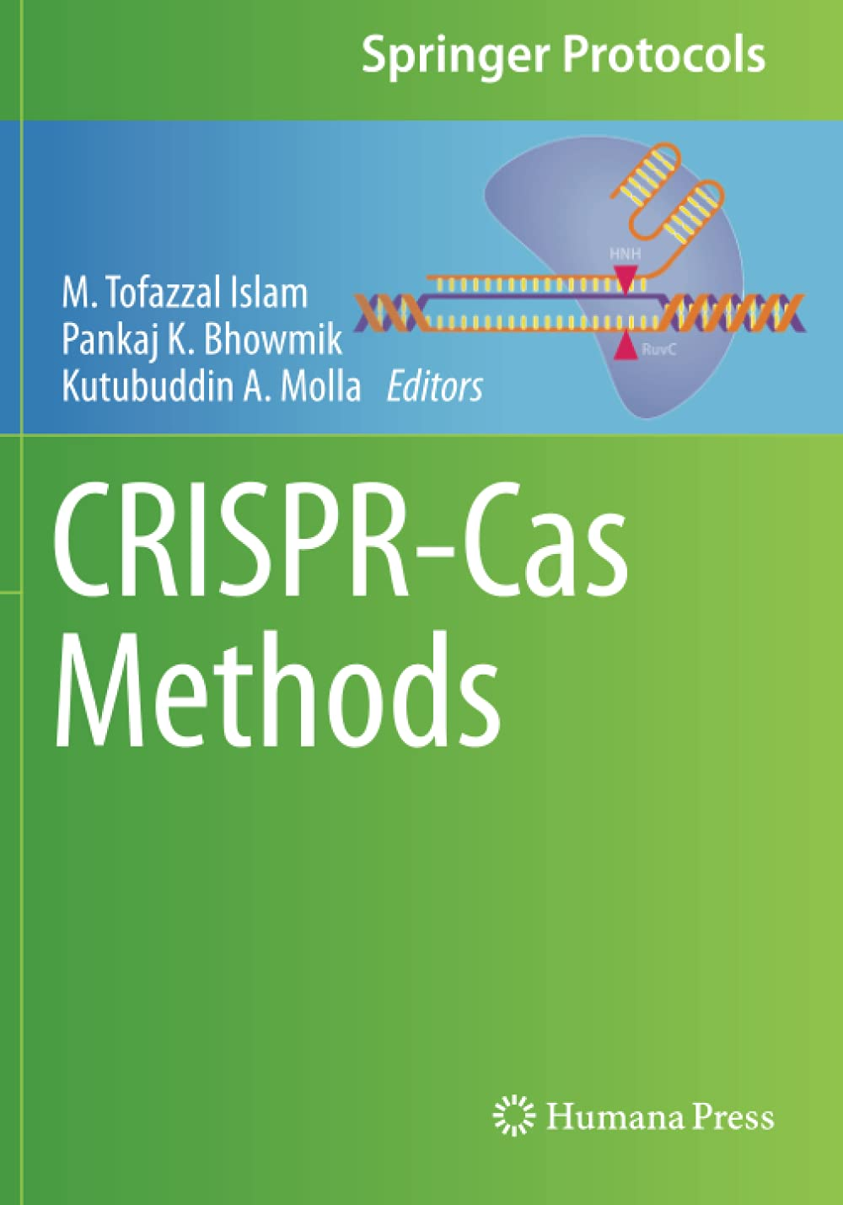

Slide 3
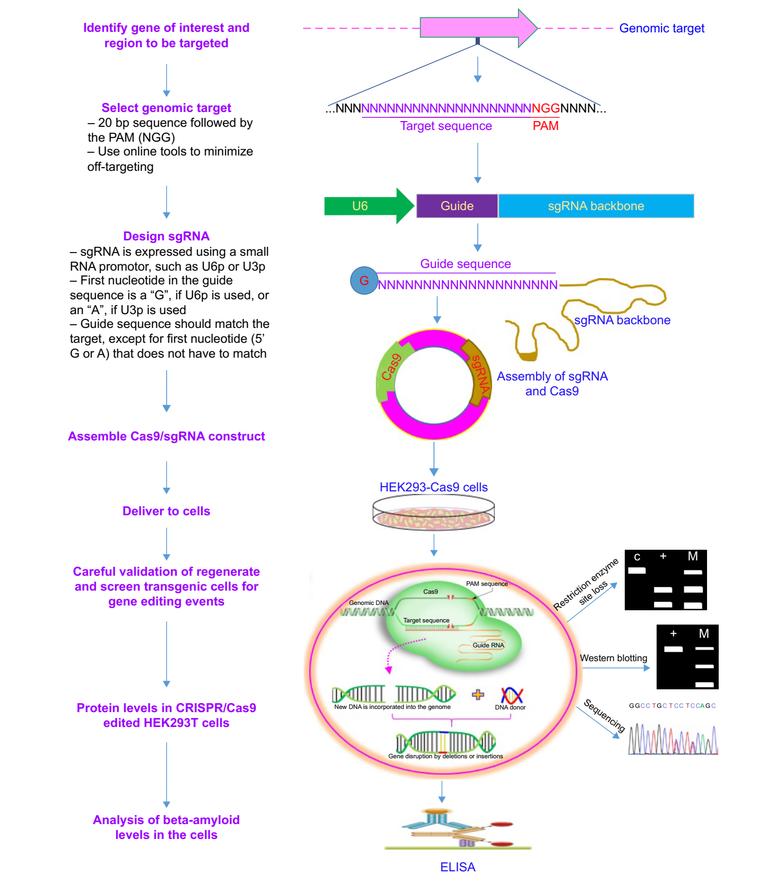
Source:

Slide 4
STEP 1: SELECT GENOMIC TARGET
The following are some important points to follow while selecting genomic sequence for editing using CRISPR-Cas9:
Choose a sequence that is relatively short and easy to edit. CRISPR-Cas9 is most efficient at editing short sequences of DNA, typically less than 20 nucleotides long.
Choose a sequence that is unique in the genome. This will help to reduce the risk of off-target effects, which are mutations that occur at unintended locations in the genome.
Choose a sequence that is flanked by a PAM sequence. PAM sequences are short DNA sequences that are required for Cas9 to recognize and cleave the DNA.
Choose a sequence that is located in a non-essential region of the genome. This will help to reduce the risk of harming the cell if the edit is not successful.

Slide 6
It is important to avoid targeting sequences that are involved in viral replication or pathogenicity
Maintaining Viral Viability: Targeting sequences essential for viral replication would disrupt the virus's ability to replicate and infect new cells. This could inadvertently eliminate the virus being targeted, rendering the editing process ineffective.
Preventing Unintended Virulence: Targeting sequences involved in viral pathogenicity, such as those encoding virulence factors, could lead to unintended consequences. Altering these sequences might inadvertently enhance the virus's virulence, making it more harmful to the host.
Ensuring Controlled Experimentation: Targeting non-essential sequences allows for controlled experimentation without compromising viral viability or altering its pathogenic properties. This enables researchers to study specific gene functions and their effects on viral behavior without interfering with the virus's fundamental processes.
Reducing Off-Target Effects: Targeting non-essential sequences minimizes the risk of off-target effects, which are unintended mutations in other parts of the genome. This is particularly important when working with viruses, as off-target effects could lead to unforeseen consequences.
Promoting Translation Research: Editing non-essential genes facilitates the translation of research findings into potential antiviral therapies. By identifying and modifying genes that don't affect viral viability or pathogenicity, researchers can pave the way for developing novel antiviral strategies without compromising the effectiveness of existing treatments.
In summary, avoiding targeting sequences involved in viral replication or pathogenicity is essential for maintaining viral viability, preventing unintended virulence, ensuring controlled experimentation, reducing off-target effects, and promoting translation research.

Slide 7
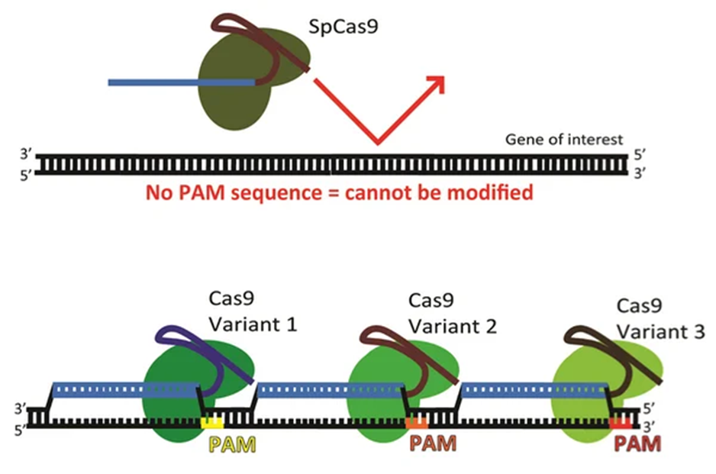
PAM (protospacer adjacent motif) : When selecting a target site for editing, it's essential to consider several important points related to PAM to ensure efficient and specific editing
PAM Sequence Specificity: Different Cas9 enzymes recognize distinct PAM sequences. Choose a Cas9 enzyme that is compatible with the PAM sequence present at your target site. For instance, the most commonly used Cas9 enzyme from Streptococcus pyogenes (SpCas9) recognizes the PAM sequence NGG.
PAM Proximity: The PAM sequence should be located adjacent to the target site, typically within 2-5 nucleotides. This ensures that Cas9 can effectively bind and cleave the DNA at the intended location.

Slide 8
PAM Availability: Ensure that the PAM sequence is present on both strands of the DNA at the target site. This allows Cas9 to bind and cleave either strand, increasing the efficiency of editing.
PAM Off-Target Effects: Minimize the presence of similar PAM sequences elsewhere in the genome. This reduces the risk of Cas9 binding to off-target sites and causing unintended mutations.
By carefully considering these points related to PAM, researchers can effectively harness the CRISPR-Cas9 system for precise and targeted genome editing, minimizing off-target effects and maximizing editing efficiency.
NOTE : Off-target genome editing refers to nonspecific and unintended genetic modifications

Slide 9
STEP 2: Design single stranded guide RNA (sgRNA)

Slide 10
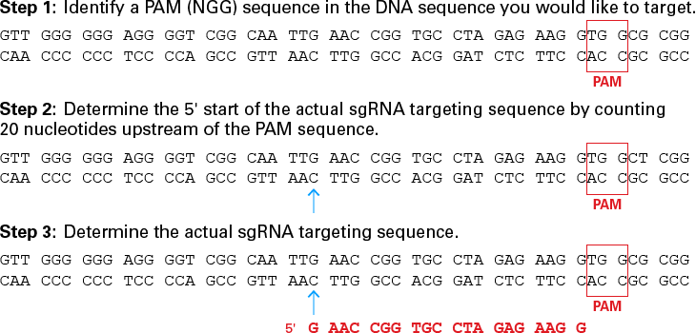

Slide 11
Designing effective sgRNAs (single guide RNAs) is crucial for successful CRISPR-Cas9 genome editing
Specificity: Ensure the sgRNA targets the desired genomic location with high specificity to minimize off-target effects. Use online tools and identify potential off-target sites.
GC Content: Aim for a GC content between 40-60% in the sgRNA sequence. This range promotes efficient DNA binding and Cas9-mediated cleavage.
Self-Complementarity: Avoid extensive self-complementary regions within the sgRNA sequence, as these can lead to hairpin formation and reduced editing efficiency.
5' End Recognition: The 5' end of the sgRNA sequence (the 20 nucleotides closest to the PAM sequence) is crucial for Cas9 recognition and target site binding. Ensure this region is highly specific to the target site.
3' End Tolerance: The 3' end of the sgRNA sequence (the nucleotides beyond the PAM sequence) is less critical for target site recognition. Mismatches at the 3' end are generally tolerated, but extensive mismatches may reduce editing efficiency.
sgRNA Expression: Select a promoter that efficiently drives sgRNA expression in the desired cell type. Avoid promoters that interfere with sgRNA processing or Cas9 activity.
sgRNA Purity: Ensure the sgRNA used for editing is of high purity to minimize the presence of truncated or mismatched sgRNAs, which can reduce editing efficiency and increase off-target effects.
sgRNA Validation: Experimentally validate the chosen sgRNA sequence using techniques like Surveyor nuclease assay or T7 endonuclease I assay to confirm its ability to direct Cas9 to the target site and induce efficient editing.
sgRNA Optimization: Consider using sgRNA optimization tools or algorithms to identify sgRNAs with high specificity and editing efficiency. These tools can help refine sgRNA design and improve editing outcomes.

Slide 12
Several rules were proposed to minimize off-target effects, including that
(1) the potential off-target sequences should not be followed by a PAM with either a 50-NGG or 50-NAG sequence
(2) the minimum mismatches between sgRNA and potential off-target sites should be limited to 3 nt and at least two mismatches are better in the proximal PAM region.

Slide 14
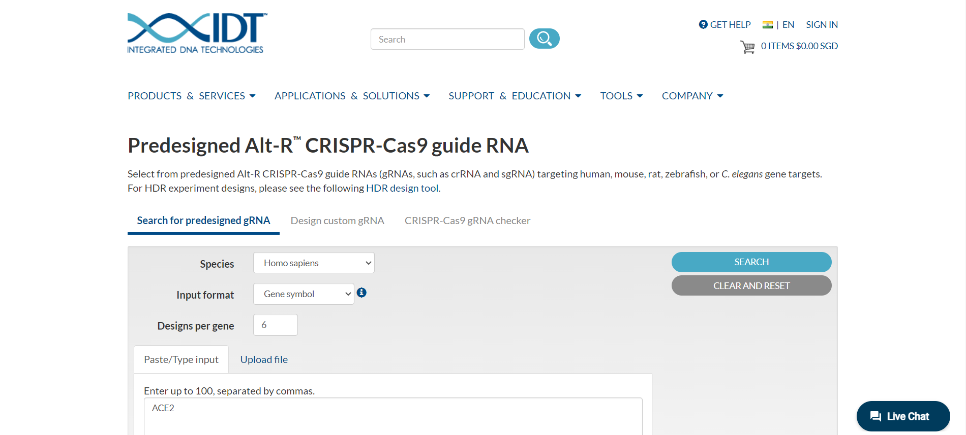

Slide 15
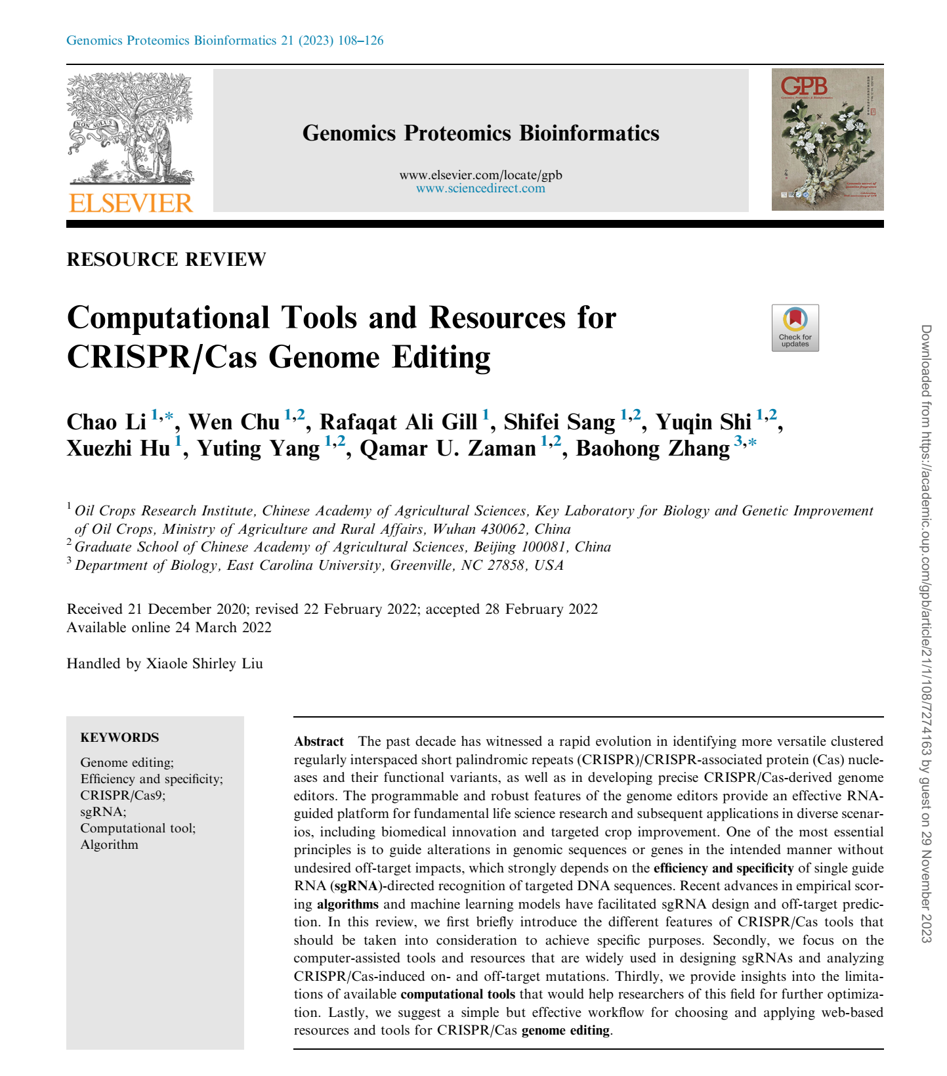

Slide 16
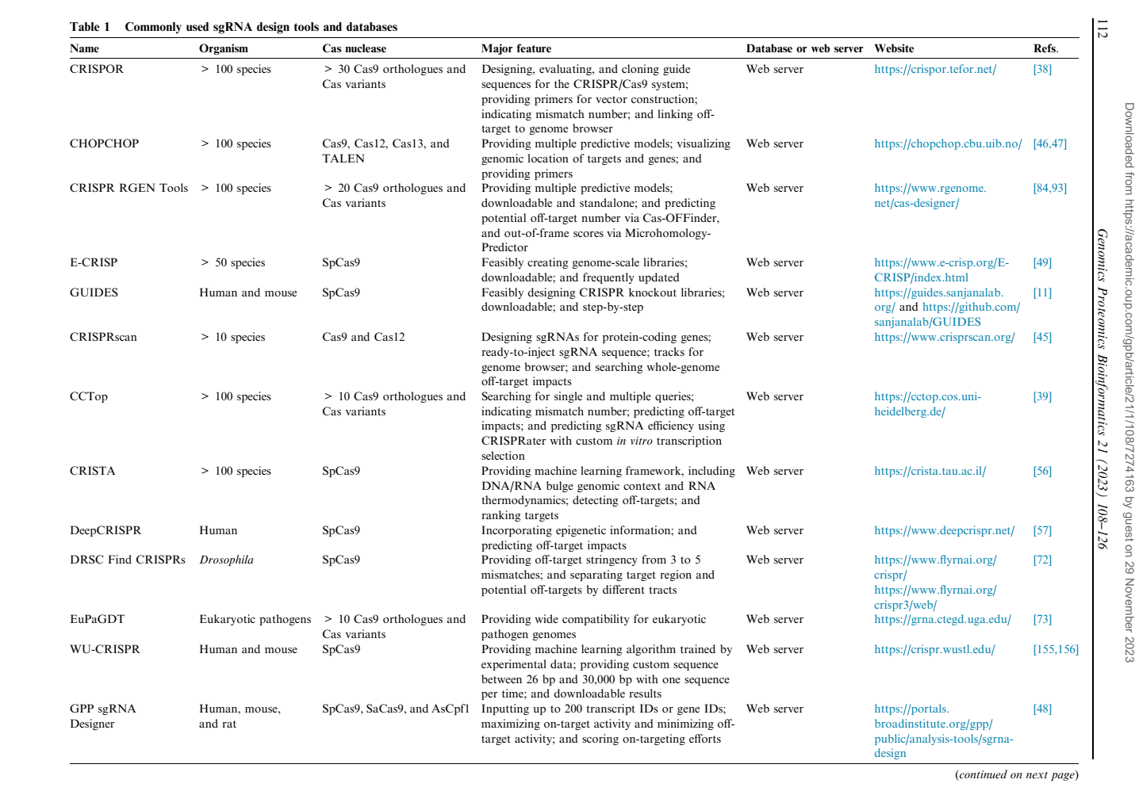

Slide 17
Downstream analysis is a crucial step in CRISPR-Cas9 genome editing experiments to evaluate the effectiveness of the editing and assess any potential off-target effects. It involves analyzing the genomic DNA, RNA, and protein expression of the edited cells or organisms to determine the impact of the edits.
Evaluating Editing Efficiency: Downstream analysis allows researchers to quantify the proportion of cells or organisms that have been successfully edited, providing insights into the efficiency of the CRISPR-Cas9 system and the chosen sgRNA design.
Detecting Off-target Effects: CRISPR-Cas9 can occasionally induce unintended mutations at sites other than the intended target site, known as off-target effects. Downstream analysis is essential for identifying and characterizing these off-target effects, ensuring the safety and specificity of the editing process.
Characterizing Gene Function: By analyzing the phenotypic changes resulting from CRISPR-Cas9-mediated gene edits, researchers can gain valuable insights into the function of the edited genes and their impact on cellular processes, physiology, and disease development.
Optimizing Editing Strategies: Downstream analysis provides feedback on the effectiveness of different sgRNAs and editing strategies, enabling researchers to optimize their experimental protocols and improve editing efficiency and specificity.
Tools and Resources for Downstream An

Slide 18
Tools and Resources for Downstream Analysis:
Genomic DNA Analysis: PCR, Sanger sequencing, and next-generation sequencing techniques are commonly used to analyze genomic DNA and detect mutations introduced by CRISPR-Cas9 editing.
RNA Analysis: RT-qPCR and RNA-seq are used to quantify changes in gene expression levels following CRISPR-Cas9 editing.
Protein Expression Analysis: Western blotting, ELISA, and flow cytometry are used to measure protein expression levels and assess the functional consequences of CRISPR-Cas9 editing.
Bioinformatics Tools: A variety of bioinformatics tools are available to assist with downstream analysis, including tools for sgRNA design, off-target prediction, and data analysis.
Databases and Resources: Online databases like CRISPR-DB and InDelphi provide information on CRISPR-Cas9 reagents, target sites, and off-target effects.

Slide 19
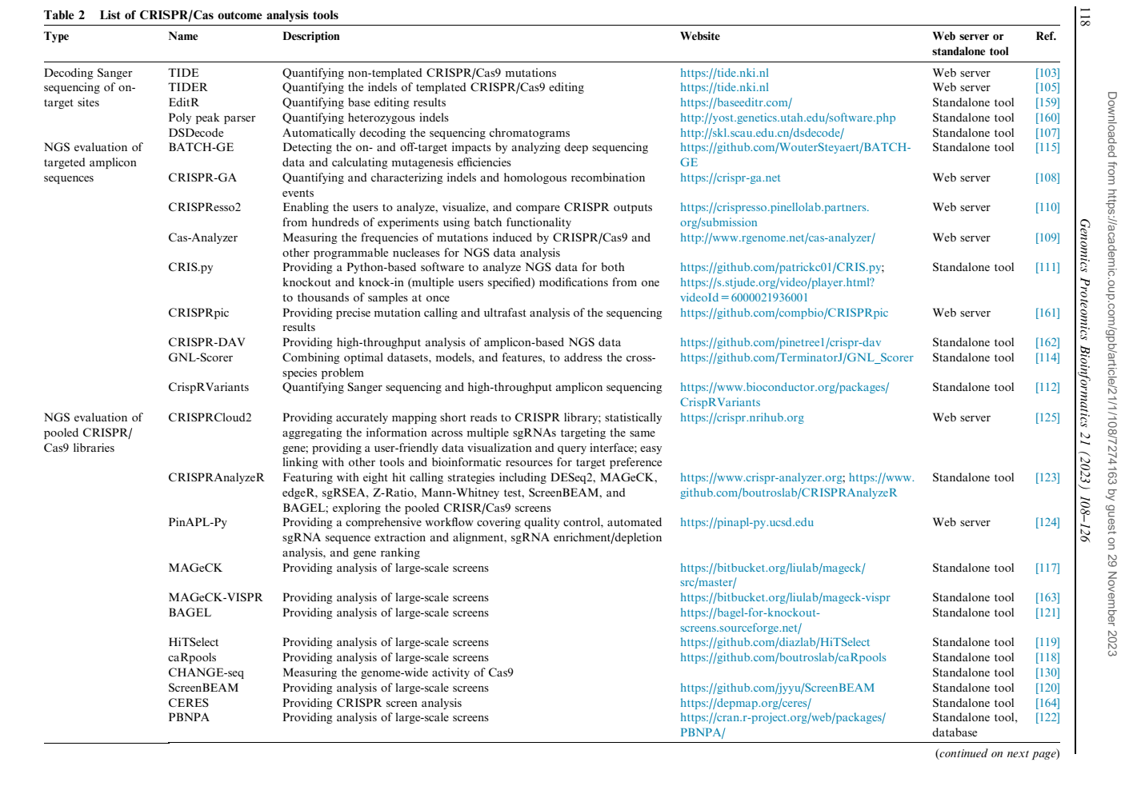

Slide 20
STEP 3: Assembly of sgRNA/Cas9 Complex
The important steps to follow during the assembly of sgRNA and Cas9 complex are:
Thaw the sgRNA and Cas9 components on ice.
Combine the sgRNA and Cas9 components in a reaction tube. The ratio of sgRNA to Cas9 will vary depending on the specific components used. Follow the manufacturer's instructions for optimal results.
Incubate the reaction mixture at room temperature for 15-30 minutes to allow the sgRNA and Cas9 to assemble into a complex.
The sgRNA/Cas9 complex is now ready to use for genome editing.
Here are some additional tips for assembling the sgRNA/Cas9 complex:
Use high-quality sgRNA and Cas9 components. Impure or degraded components can reduce the efficiency and specificity of genome editing.
Use a nuclease-free reaction buffer to prevent degradation of the sgRNA and Cas9 components.
Incubate the reaction mixture at room temperature to avoid denaturing the sgRNA and Cas9 proteins.
Avoid pipetting the reaction mixture vigorously, as this can shear the sgRNA and Cas9 proteins.

Slide 21
Once the sgRNA/Cas9 complex is assembled, it can be used to edit genomic DNA in a variety of ways, such as:
Transfection: The sgRNA/Cas9 complex can be transfected into cells using a variety of transfection methods. Once inside the cell, the sgRNA/Cas9 complex will guide Cas9 to the target site in the genome and induce a double-strand break. The cell's natural DNA repair mechanisms will then repair the break, which can lead to the insertion, deletion, or replacement of nucleotides at the target site.
Electroporation: The sgRNA/Cas9 complex can also be delivered into cells using electroporation. Electroporation is a technique that uses an electric field to create pores in the cell membrane, allowing the sgRNA/Cas9 complex to enter the cell.
Microinjection: The sgRNA/Cas9 complex can also be microinjected directly into the cytoplasm of cells. Microinjection is a precise technique that allows researchers to target specific cells with the sgRNA/Cas9 complex.
The assembly of the sgRNA/Cas9 complex is a relatively simple process, but it is important to follow the steps carefully to ensure that the complex is assembled correctly and efficiently.

Slide 22
When inserting the sgRNA/Cas9 complex into target cells, several important points should be considered to ensure successful genome editing:
Cell Type and Viability: Choose cells that are actively dividing and in good health to maximize the likelihood of successful editing. Consider the compatibility of the chosen cell line with the delivery method and the sgRNA sequence.
sgRNA/Cas9 Complex Concentration: Optimize the concentration of the sgRNA/Cas9 complex to achieve efficient editing without causing cytotoxicity. Start with lower concentrations and gradually increase if necessary.
Delivery Method: Select an appropriate delivery method based on the cell type and desired editing efficiency. Common methods include transfection using viral or non-viral vectors, electroporation, and microinjection.
Delivery Timing: Determine the optimal timing for delivery of the sgRNA/Cas9 complex. Consider the cell cycle and the timing of gene expression to maximize editing efficiency.
Post-Delivery Incubation: Allow sufficient incubation time for the sgRNA/Cas9 complex to enter the cells and induce DNA cleavage. The incubation time may vary depending on the cell type and delivery method.
Selection of Edited Cells: Implement a selection strategy to isolate edited cells from non-edited cells. This may involve using antibiotic resistance markers or fluorescence-based selection systems.
Editing Efficiency Assessment: Quantify the editing efficiency using techniques like T7 endonuclease I assay or Surveyor nuclease assay to determine the percentage of cells with the desired edit.
Off-Target Effects Assessment: Analyze potential off-target effects using techniques like whole-genome sequencing or targeted sequencing to identify unintended mutations.
Functional Characterization: Assess the functional consequences of the edit by analyzing changes in gene expression, protein levels, or cellular phenotypes.
Optimizing Protocols: Refine the experimental protocols based on the results, adjusting sgRNA/Cas9 concentration, delivery method, and incubation time to improve editing efficiency and reduce off-target effects.

Slide 23
Careful validation of selected transgenic cells produced in CRISPR/Cas9 is essential to ensure the accuracy and specificity of genome editing and to minimize potential off-target effects. The validation process should include multiple steps to assess the editing efficiency, verify the desired genetic modifications, and rule out unintended mutations.
1. Editing Efficiency Assessment:
Quantify the proportion of cells with the desired edit. This can be done using techniques like T7 endonuclease I assay, Surveyor nuclease assay, or next-generation sequencing.
Evaluate editing efficiency across the cell population. Assess the homogeneity of editing to ensure that the desired modification is present in a consistent proportion of cells.
2. Verification of Desired Genetic Modifications:
Confirm the presence of the intended genetic modification. Use Sanger sequencing or next-generation sequencing to directly sequence the edited region and confirm the presence of the desired insertion, deletion, or substitution.
Analyze the pattern of editing. Assess whether the editing is restricted to the intended target site and that there are no unintended modifications at off-target sites.
3. Off-target Effect Assessment:
Screen for potential off-target effects. Use computational tools to predict potential off-target sites and experimentally validate them using techniques like T7 endonuclease I assay or targeted sequencing.
Assess the functional consequences of off-target effects. If off-target effects are detected, evaluate their impact on gene function, cellular processes, or physiological outcomes.
4. Functional Characterization:
Analyze changes in gene expression. Measure mRNA levels using RT-qPCR or RNA-seq to assess the impact of editing on gene transcription.
Evaluate protein expression. Determine protein abundance using Western blotting, ELISA, or flow cytometry to assess the impact of editing on protein translation.
Characterize phenotypic changes. Analyze the functional consequences of editing on cellular phenotypes, morphology, or behavior.
5. Additional Considerations:
Use multiple validation methods. Employ a combination of techniques to ensure comprehensive and reliable assessment of editing efficiency, specificity, and functional consequences.
Utilize appropriate controls. Include wild-type cells and non-edited cells as controls to distinguish between the effects of editing and natural variation or experimental conditions.
Document the validation process. Maintain detailed records of experimental procedures, results, and interpretations to facilitate reproducibility and transparency.

Slide 24
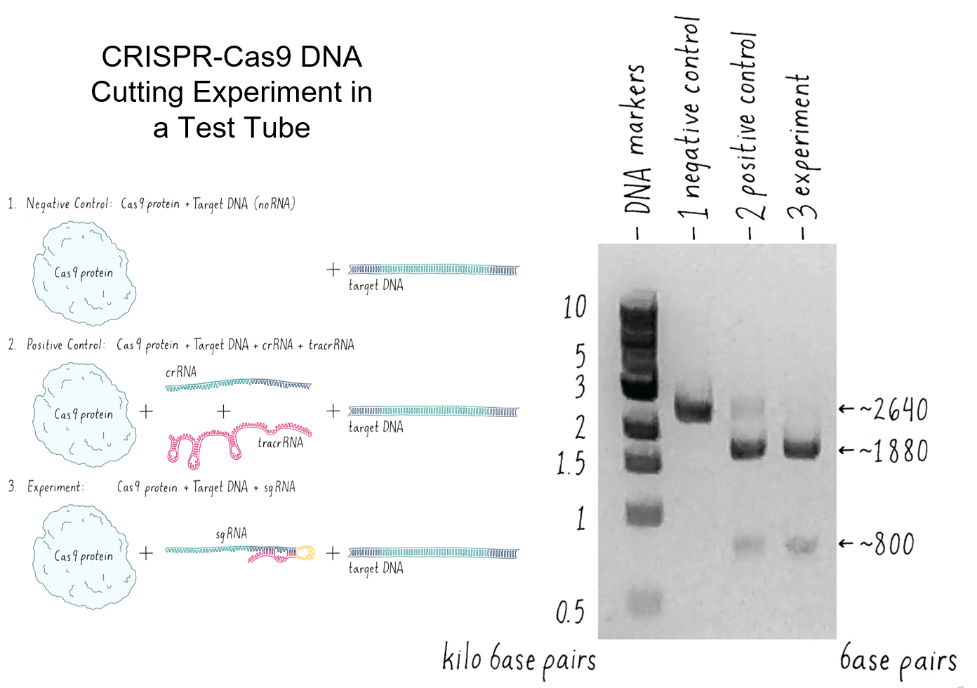
4. Functional Characterization:
Analyze changes in gene expression. Measure mRNA levels using RT-qPCR or RNA-seq to assess the impact of editing on gene transcription.
Evaluate protein expression. Determine protein abundance using Western blotting, ELISA, or flow cytometry to assess the impact of editing on protein translation.
Characterize phenotypic changes. Analyze the functional consequences of editing on cellular phenotypes, morphology, or behavior.
5. Additional Considerations:
Use multiple validation methods. Employ a combination of techniques to ensure comprehensive and reliable assessment of editing efficiency, specificity, and functional consequences.
Utilize appropriate controls. Include wild-type cells and non-edited cells as controls to distinguish between the effects of editing and natural variation or experimental conditions.
Document the validation process. Maintain detailed records of experimental procedures, results, and interpretations to facilitate reproducibility and transparency.
By rigorously validating transgenic cells produced using CRISPR/Cas9, researchers can establish the reliability of their editing experiments, minimize the risk of unintended effects, and generate trustworthy data for further research and potential therapeutic applications.

Slide 25
ICAR-NRRI CRISPR Cas9 TEAM
THANK YOU!
darshan.panda216@gmail.com
WhatsApp- +917008284458

